Slide 1
In-vitro Biology

Slide 2
Cell based assays

Slide 3
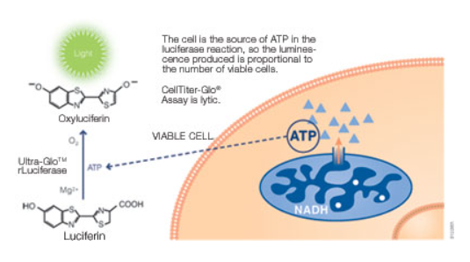
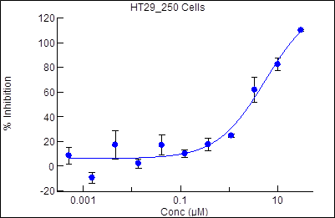
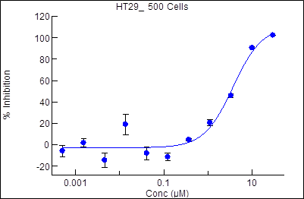
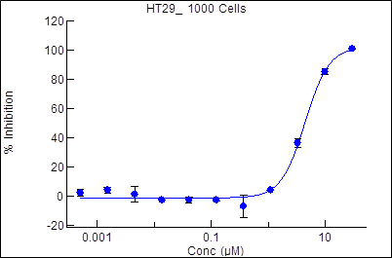
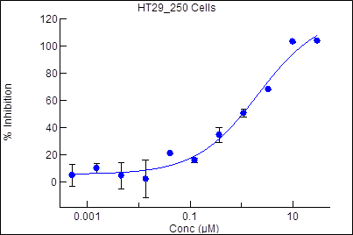
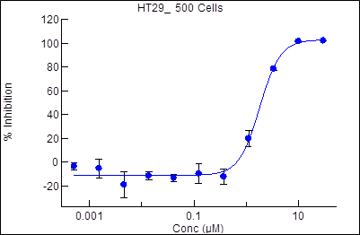
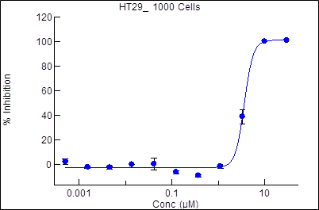
Case study: Cell Proliferation by Cell Titre Glo
Assay principle:
Cell Number & Treatment Time Optimization in HT29
250 cells/well
500 cells/well
1000 cells/well
IC50-
5.4 µM
IC50-
3.7 µM
IC50-
4.4 µM
Day 3
High signal
No signal
Brief Protocol:
Seed cells in 40µL of growth media with
; 250, 500 & 1000 cells/well.
Termination- Add equal volume of CTG
(50 µL), incubate at RT for 10 mins. Read on Envision plate reader
Treat with 10 µL of 5X compound stock. Final DMSO - 0.5%
IC50-
2.1 µM
IC50-
1.8 µM
IC50-
3.7 µM
Day 5
Overnight, 37°C, 5 % CO₂
From the above experiment Day 5 with 500 cells/well were taken forward
Quantification: Luminescence
Instrument used: Envision 2105
QC parameters used for assay:
a) % CV – < 20 %
b) Z’ > 0.5
c) Signal Window : 25
Incubation for 3, 5 days, 37°C, 5 % CO₂
Kit Used- CellTiter-Glo®- Promega (G7571)

Slide 4
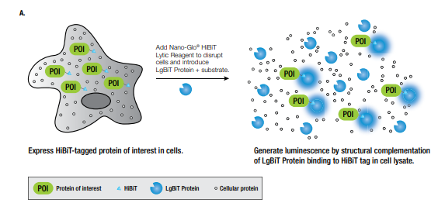
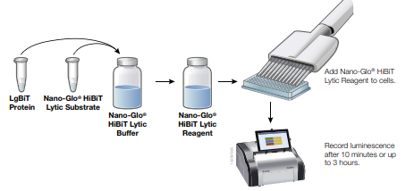
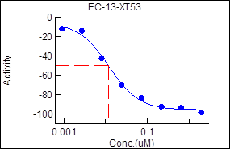
In-vitro Selectivity assay - HiBiT assay
Assay principle:
DRC of tool compound in HiBiT cell line
Brief Protocol:
Seed cells in 30µL of growth media; 1000 cells/well.
Termination- Add 40 µl of HiBiT lytic reagent
incubate at RT for 10 mins. Read luminescence on VictorX5 plate reader
Treat with 10 µL of 4X compound stock.
Plate format: 384-well
Quantification: Luminescence
Instrument used: Victor X5 multimode plate reader
QC parameters used for assay:
a) % CV: < 20 %
b) Z’: > 0.4
c) Signal Window : 5
Overnight, 37°C, 5 % CO₂
Incubation for 24 hr,
37°C, 5 % CO₂
~ 1300 compounds screened for an FTE programme using this assay technology. HiBiT cell line was provided by client..
Kit Used- Nano-Glo® HiBiT Lytic Detection System- Promega (N3040)

Slide 5
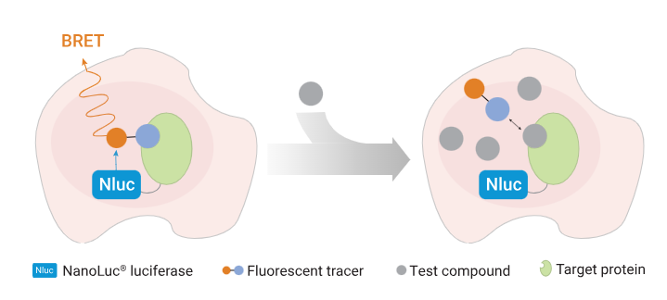
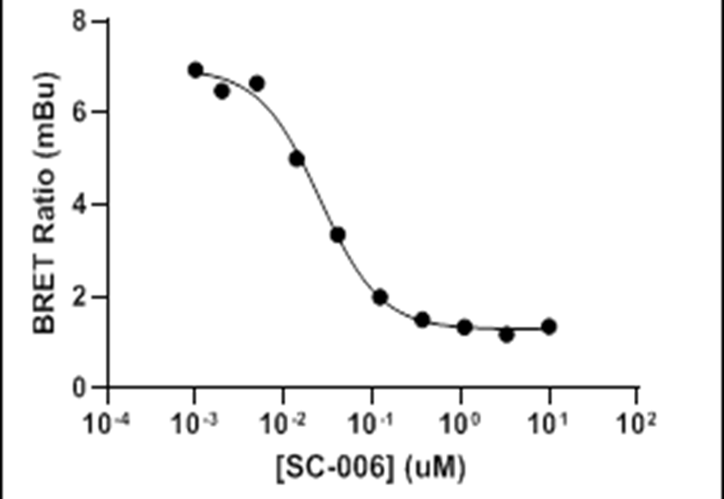
NanoBRET Target Engagement Intracellular kinase Assay
Assay principle:
IC50-
0.03 µM
Brief Protocol:
Day 1- Cell density – 0.2 x 10⁶ /ml
Target Vector: Carrier DNA – 1:9
(Target Vector: Carrier DNA) : FuGENE – 1:3
Seed transfected cells in 96 well solid white plate
Add NanoBRET substrate
Day 2: Add Tracer + Test Compound
Read plate in Envision Plate Reader
Donor Emission – 460 nm; Acceptor Emission – 610 nm
Data representation - NanoBRET Ratio (Acceptor/Donor)
Plate format: 96 well
Quantification: Luminescence & Fluorescence
Instrument used: Envision 2105
QC parameters used for assay:
a) % CV: < 20 %
b) Z’: > 0.5
c) Signal Window : 5
Overnight, 37°C, 5 % CO₂
2hrs, 37°C, 5 % CO₂
Kit Used- NanoBRET™ TE Intracellular Assay - Promega (N2630)

Slide 6
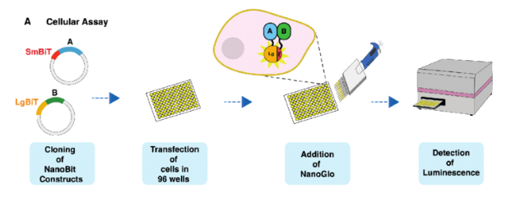
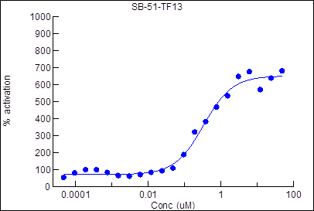
NanoBiT Assay
Assay principle:
Amax-
3.12 µM
Brief Protocol:
smBiT plasmid (10 µg) and lgBiT plasmid (10 µg) were mixed in OptiMEM medium (1000 µL) followed by addition of 60 ul of Fugene HD Transfection.
Add 2.5 ul of neddylation inhibitor (MLN4924)
Add HEK293 cells to the transfection mixture at the density of 10 million per 10 mL . Seed 18.5 ul per well in 384 white plate.
Add 3 µl of test compound and 6 µL of NanoBiT substrate and measure luminescence in Envision plate reader after 30 mins
Incubate at RT for 20 mins
Plate format: 96 well
Quantification: Luminescence
Instrument used: Envision 2105
QC parameters used for assay:
a) % CV: < 20 %
b) Z’: > 0.5
c) Signal Window : 5
Overnight incubation37°C,
5 % CO₂
Overnight incubation37°C,
5 % CO₂
Kit Used- Nanoglo Live Assay System- Promega (N2012)

Slide 7
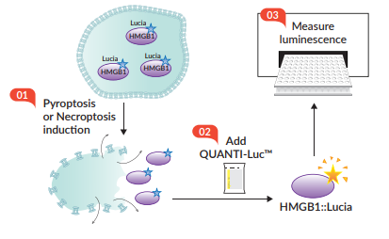
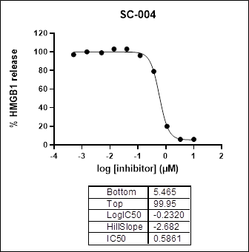
Necroptosis Assay (HMGB1 Release)
Assay principle:
IC50-
0.587 µM
Brief Protocol:
Seed 6 X 10⁴ THP1-HMGB1-Lucia cells in 96 well plate
Add 100 ng/mL of TNFα, 5 µM of BV-6 and inhibitor compounds
Add pan-caspase inhibitor, 25 µM of Zvad-FMK for 1 hr at 37⁰C, 5% CO₂.
Collect 30 µl of cell culture supernatant in 96 well Opti-plate
Add 150 µl Quanti-Luc substrate, mix and measure luminescence in Envision plate reader
Plate format: 96 well
Quantification: Luminescence
Instrument used: Envision 2105
QC parameters used for assay:
a) % CV: < 20 %
b) Z’: > 0.5
c) Signal Window : 5
16h incubation, 37°C, 5 % CO₂

Slide 8
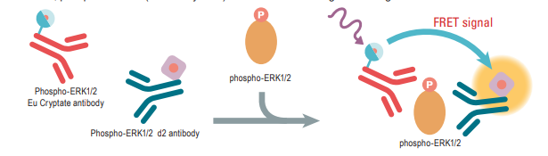
pERK HTRF of Compound X in AGS & AsPC1 cell line –3 HR treatment
Assay principle:
Brief Protocol:
IC50 – 16 nM
Day 1: : Seeding of cell lines
384 well plate (8000 cells/well)
Add Lysis Buffer 8 µL of 4X stock
Day 2: Compound Treatment
(11 points 3 folds – Top Conc – 3 µM)
Transfer 16 ul of sample to proxiplate. Add 4 ul of antibody mix (pERK Eu cryptate + pERK d2 antibody)
Reading at EX-340 nm; EM – 620 nm, 665 nm
Overnight, 37°C, 5 % CO₂
Plate format: 384 well
Quantification: Luminescence
Instrument used: Envision 2105
QC parameters used for assay:
a) % CV: < 20 %
b) Z’: > 0.5
c) Signal Window : 5
Incubate for 3 hrs
Incubate for 45 mins
Incubate for 24 hrs at RT
Kit Used- new ERK Advanced kit - Cisbio (64AERPEG)

Slide 9
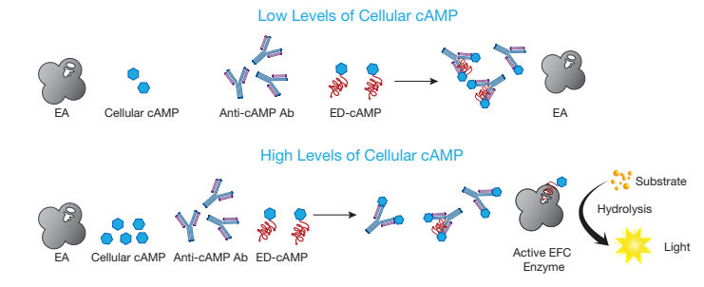
cAMP Hunter™ Liraglutide Bioassay - Protocol
Assay principle:
Brief Protocol:
IC50 – 50 nM
Day 1: : Cells are thawed and plated in 96 well plate (100 ul/well).
Add cAMP antibody reagent and cAMP working detection solution
Day 2: Add cell assay buffer (30 ul) and treat with test compounds (15 ul)
Add 60 uL cAMP solution A
Reading chemiluminescence in Envision plate reader
Overnight, 37°C, 5 % CO₂
Plate format: 96 well
Quantification: Luminescence
Instrument used: Envision 2105
QC parameters used for assay:
a) % CV: < 20 %
b) Z’: > 0.5
c) Signal Window : 5
Incubate for 30 mins
Incubate for 1hr at RT
Incubate for 3 hrs at RT
Kit Used- cAMP Hunter™ Liraglutide Bioassay Kit - DiscoverX (95-0062Y2-00099)

Slide 10
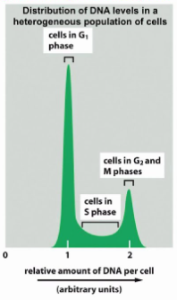
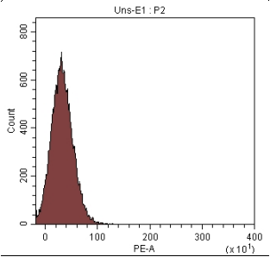
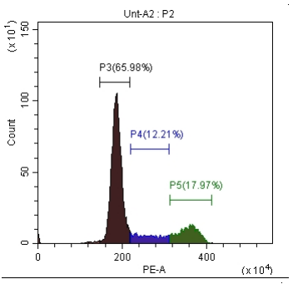
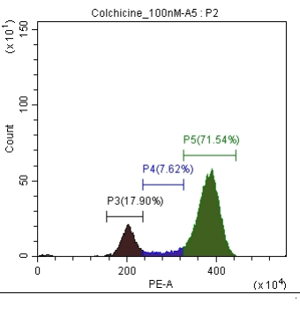
Cell Cycle analysis in the presence of compound X in NCIH358 cell line – 24 hr
Assay principle:
Unstained
DMSO Control
Colchicine_100 nM
The cell cycle profile of a sample can be determined by staining the DNA with a fluorescent dye and measuring its intensity. The dye stains DNA stoichiometrically, allowing differentiation of cells in G0/G1, S phase, and G2/M.
Brief Protocol:
Day 1: Seeding of cell line- 6 well plate (0.5 * 10^6 cells/well)
Day 3: Cells washed with Cell cycle buffer and fixed with
70 % ethanol
Day 2: Test Compound Treatment
Cells washed with Cell Cycle Buffer and stained with Dye Solution for 30 mins at RT
Cells washed and acquired in BD Cytoflex
NCIH358 | G0-G1 | S | G2-M
Unstained | 0.0 | 0.0 | 0.0
DMSO Control | 66.0 | 12.2 | 18.0
Colchicine_100 nM | 17.9 | 7.6 | 71.5
Overnight incubation
37C, 5 % CO2
Plate format: 6 well plate
Quantification:
Instrument used: Cytoflex
QC parameters used for assay:
Overnight incubation
37C, 5 % CO2
Kit Used- Cell Cycle – Sigma (MAK344)

Slide 11
Acid accumulation assay
Seed 4 X 10⁴ wild type and knockout cells in 96 well plate
Add test compound – 1uM, 5 point DRC with 3-fold dilution
Incubate assay plate for 0, 0.5, 1, 3, 24 & 48h
Lyse cells and collect supernatant
Send samples for LCMS analysis
Estimate the acid content compared to ester in the supernatant

Slide 12
Effect of IFX conjugates on TNFα induced Cytotoxicity in L929 cells
Protocol
Cell Seeding: 2000 and 5000 cells/ well in culture medium (EMEM + 10% HS+ 1% PenStrep)
Incubation for 24h at 37C, 5% CO2
IFX conjugates and TNFα treatment
Assay medium =EMEM+1% HS+ 1%Penstrep
TNFa: Final Concentration used= 5 ng/mL
Concentrations tested: 10000 ng/mL ; 3-fold dilution; 8-point DRC
Treatment time: 24h
Incubation for 24h at 37C, 5% CO2
Infliximab
Fit Cell | #Ok | IC50 (ng/mL) | 131.02
Chart Cell | #Ok | Hill slope | 2.48
Cell Titer Glo Addition
Luminescence Reading

Slide 13
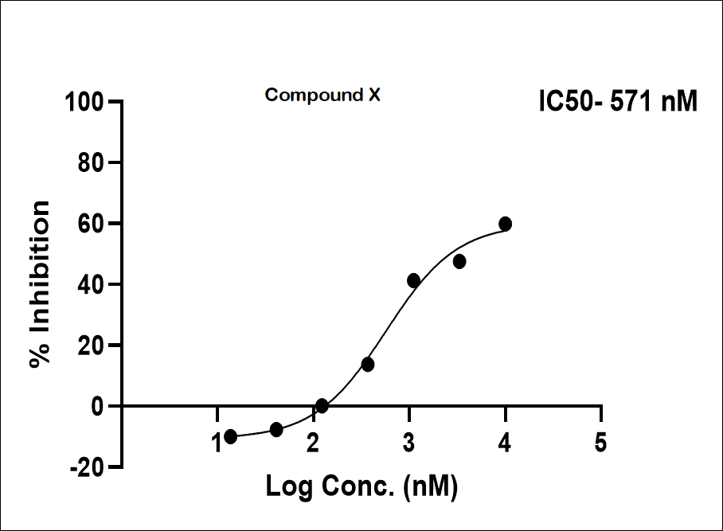
pSTATs expression in CD4/CD33 cells by Flow cytometry
Whole blood processing
Blood from healthy donor withdrawn
Whole blood used for the assay
Compound treatment and cytokine induction
Analysis
Followed by surface Abs staining at 4$°$C for 30 min.
Followed by surface Abs staining at 4°C for 30 min.
Permeabilization followed by pSTAT staining at 4$°$C for 2h
Permeabilization followed by pSTAT staining at 4°C for 2h
Treatment with compounds - 37$°$C for 30 min.
Treatment with compounds - 37°C for 30 min.
Induction with cytokines - 37$°$C for 20 min.
Induction with cytokines - 37°C for 20 min.
Fixed cells, quick wash
Expression check using flow cytometer

